Slide 1
Capstone Project Hotel Booking Analysis
By: Rohit Sharma

Slide 2
Index:
Agenda
Data summary
Data Preprocessing
Correlation Heatmap
Hotelwise Analysis
Distribution Channelwise Analysis
Time period related Analysis
Conclusion

Slide 3
Agenda :
To discuss the analysis of given hotel bookings data set from 2015-2017.
We’ll be doing analysis of given data set in following ways
• Univariate analysis
• Hotel wise analysis
• Distribution Channel wise analysis
• Booking cancellation analysis
• Timewise analysis
Conclusion

Slide 4
Data Summary:
Given data set has different columns of variables crucial for hotel bookings. Some of them are:
hotel: The category of hotels, which are two resort hotel and city hotel.
is_cancelled : The value of column show the cancellation type. If the booking was cancelled or not. Values[0,1], where 0 indicates not cancelled.
lead_time : The time between reservation and actual arrival.
stayed_in_weekend_nights: The number of weekend nights stay per reservation
stayed_in_weekday_nights: The number of weekday nights stay per reservation.
meal: Meal preferences per reservation.[BB,FB,HB,SC,Undefined]
Country: The origin country of guest.

Slide 5
Univariate Analysis :
While doing univariate analysis of given hotel booking dataset, we answered following questions:
Which agent made most of bookings?
Which room type is in most demand ?
(3) From which country most of the customers are coming?
(4) What is the most preferred meal by customers?

Slide 6
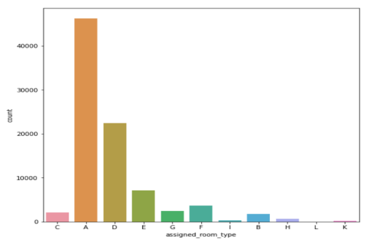
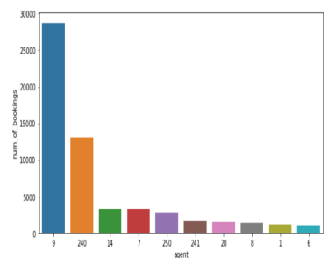
Type A room is most demanded by customers.
Agent with id no. 9 made most of the bookings.

Slide 7
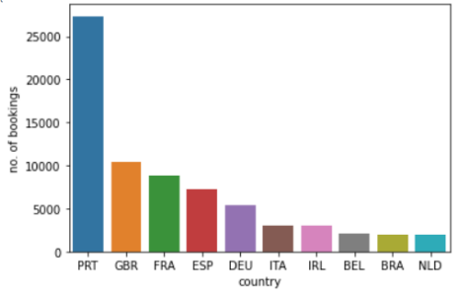
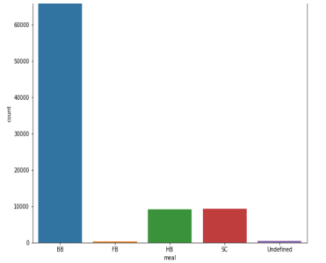
Mostly customers are from Portugal, Great Britain, France and Spain.
Most preferred meal type is BB( Bed and breakfast).

Slide 8
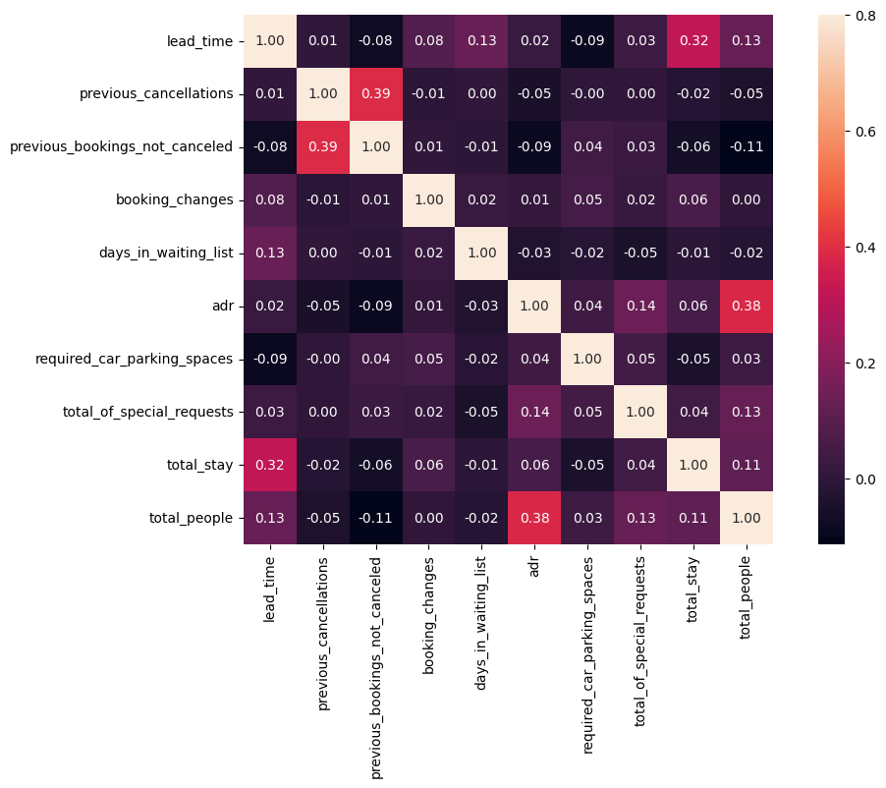
Correlation and Heatmap:
As we can see in heatmap we have some moderate correlations:
Total Stay and lead Time
It says that for long period stay people make advance bookings.
Total People and adr
it says that more the people more the revenue.

Slide 9
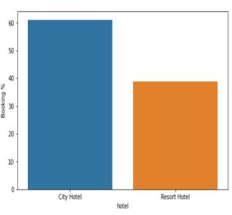
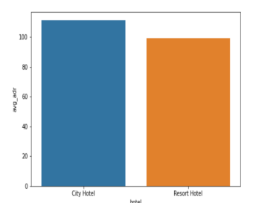
Hotelwise Analysis:
Percentage of bookings in each hotels?
City hotel is 20% higher bookings then Resort hotel.
Which hotel makes more revenue?
City Hotel makes slightly more revenue as compare to Resort Hotel.

Slide 10
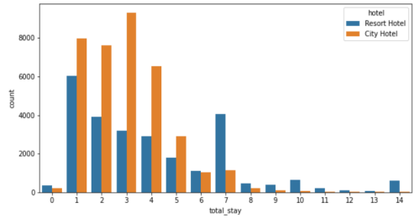
What is most preferred stay length in each hotel?
For short time period (4-6 days) City hotel is preferred but for long stay Resort Hotel is preferred because of low ADR.

Slide 11
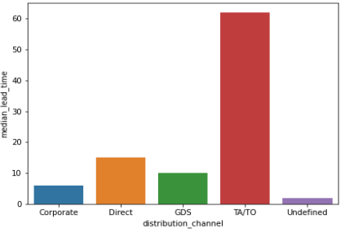
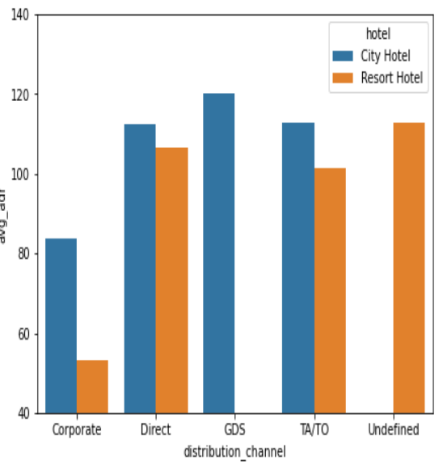
Distribution channel wise Analysis
Which distribution channel brings better revenue generating deals for hotels?
For City Hotel GDS generates more revenue and as for Resort Hotel Direct channel is making fortune.
Which is the most common channel for booking hotels?
TA/TO is most common channel used for booking.

Slide 12
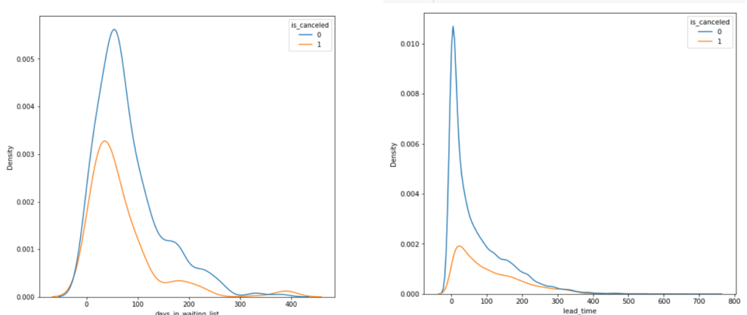
Booking cancellation Analysis
Longer time (in days) in waiting list

Slide 13
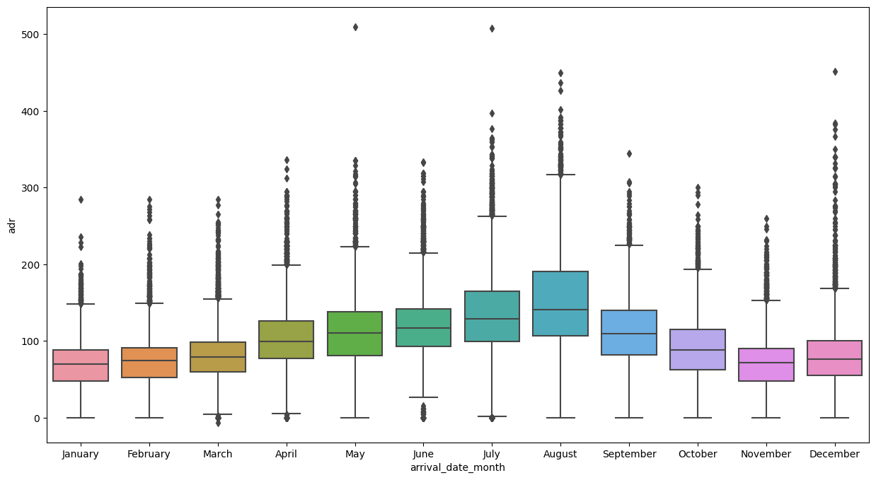
Time-wise Analysis
What are the most busy months for hotels?
(2) In which months hotels charges higher adr?
In first half of the year revenue increases and attain peak on August but goes down in second half but make few great deals in last month.

Slide 14
Conclusion :
On the basis of above analysis these conclusion are made:
Most demanding room type is 'A'.
Agent '9' makes the highest bookings.
Most people visits hotel from Portugal, Great Britain and France.
City Hotel has higher booking %, revanue, waiting time, cancellation rate then Resort Hotel.
City hotel is more preferred for short time period but for long time periiod Resort Hotel is highly preferred because of less adr.
Returning rate of customer at Resort Hotel is higher then City Hotel.
TA/TO are mostly used Distribution channel.
GDS makes the highest revanue but DIrect and TA/To are very close.
Monthly revanue : in first half of year revanue increases and at peak on August then downfall starts but at the end of year it gets some great deals.
2017 makes the highest revanue in last three years.

